Slide 1
Site-level BDII installation & configuration tutorial (http://www.pd.infn.it/~aiftim/ )
Cristina Aiftimiei (INFN)
EMI Release Manager
EGI Technical Forum 2012
17-21 Sep. 2012

Slide 2
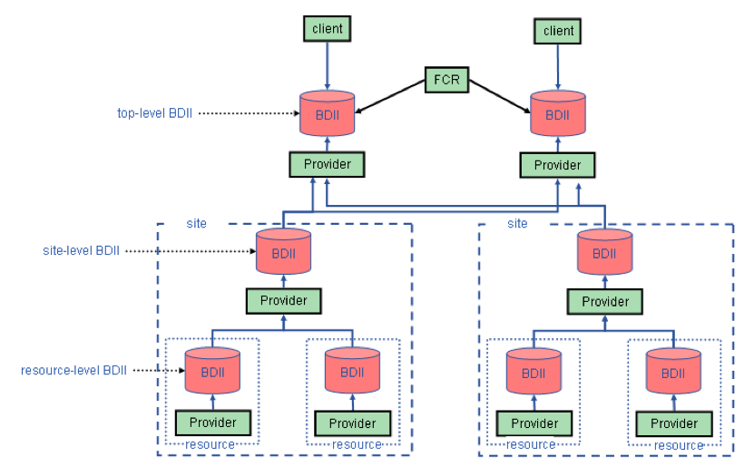
Grid Information System - structure

Slide 3
Documentation
gLite Information System - home page:
https://tomtools.cern.ch/confluence/display/IS/Home
EMI Generic Installation & Configuration:
https://twiki.cern.ch/twiki/bin/view/EMI/GenericInstallationConfigurationEMI2
BDII SiteAdmin Guide:
https://tomtools.cern.ch/confluence/download/attachments/983044/EMI_BDII_sysadmin.pdf
How to publish Site information:
https://wiki.egi.eu/wiki/MAN1_How_to_publish_Site_Information
BDII ServiceReferenceCard:
https://twiki.cern.ch/twiki/bin/view/EMI/GLiteInformationSystem
Glue-Validator Guide:
https://tomtools.cern.ch/confluence/display/IS/Glue+Validator+Guide
BDII High Availability Check List:
https://tomtools.cern.ch/confluence/display/IS/BDIIHAchecklist
OpenLDAP documentation:
www.openldap.org

Slide 4
Step 0 – prerequisites
Hardware:
CPU: dual core CPU
Disk: 10GB of hard disk space
Memory: 2-3 GB RAM(*)
Network: port 2170 needs to be open
Software:
OS: SL 5 (EMI 1 and 2) and SL 6 (EMI 2)
Python version: Python 2.5 in SL5, 2.6 in SL6
OpenLDAP software: OpenLdap 2.4 from SL or EMI third-party repositories
Host certificates: NOT needed (**)
Recommended deployment scenarios:
co-hosting – if possible should be avoided
“In no circumstances should the BDII be co-hosted with a service which has the potential to generate a high load.”
Physical vs Virtual Machines:
management and disaster recovery of any service deployed under a virtual machine is more flexible and easier
Notes:
(*) If you decide to set BDII_RAM_DISK=yes in your YAIM configuration, it's advisable to have 4GB of RAM.
(**) No CA CRLs needed

Slide 5
Step 1 – installation
OS installation:
See OS specific documentation
Node synchronization, NTP installation and configuration
crontab & logrotate utilities
Repositories:
CA repository – not needed
DAG – MUST be disabled
EPEL – use latest epel-release
EMI repositories:
Import EMI public key
get latest emi-release (wget)
Install it (yum localinstall)
Install site-level BDII metapackage:
emi-bdii-site

Slide 6
Step 2 – understand config.
Automatic configuration – YAIM
“common” variables for resource, site, top level BDIIs:
SITE_NAME
GlueSiteName attribute
BDII_BREATHE_TIME
time between updates, default 120(s)
BDII_READ_TIMEOUT
seconds to wait until an information is considered “old”
Default 300(s)
BDII_ARCHIVE_SIZE
Number of BDII db dumps for debug
Default: 0
BDII_IPV6_SUPPORT
enables IPv6 support
Default: no

Slide 7
Step 2 – understand config. (II)
Specific variables for site-level BDII:
SITE_BDII_HOST
BDII_RAM_DISK
Whether or not RAM disk is used to improve performance
Default: No
SLAPD
Stand-alone LDAP daemon location.
Default: /usr/sbin/slapd
SLAPD_CONF
Config. file location for slapd.
Default: /etc/bdii/bdii- slapd.conf
BDII_DELETE_DELAY
Time to wait in seconds before deleting removed entries
Default: 0
Notes:
(*) – activates the caching mode – topBDII

Slide 8
Step 2 – understand config. (III)
BDII_REGIONS
List of host identifiers publishing information to the BDI
IMPORTANT – BDII itself should be present
EX: BDII_REGIONS="CE SE BDII"
BDII_<host-id>_URL
URL of the information producer
EX: BDII_BDII_URL="ldap://<site-bdii-host>:2170/mds-vo-name=resource,o=grid"
SITE_DESC , SITE_EMAIL, SITE_LOC, SITE_LAT, SITE_LONG
SITE_WEB, SITE_SECURITY_ EMAIL, SITE_SUPPORT_ EMAIL
SITE_OTHER_GRID
Grid to which your site belongs.
EX: SITE_OTHER_GRID=” WLCG|EGI”

Slide 9
Step 2 – understand config. (IV)
Advanced configuration – manually
common configuration file - /etc/bdii/bdii.conf
specific site-level BDII files:
/etc/bdii/bdii-slapd.conf
/etc/glite-info-static/site/site.cfg
/etc/bdii/gip/site-urls.conf

Slide 10
Step 3 – customize & configure
How to publish Site information
recommendations & examples on the content of GlueSite Object to be set
Established Grid Names –like EGI, EELA, WLCG
Valid WLCG Names – like CERN, IT-INFN-CNAF
YAIM variables examples
Customize YAIM examples/ files:
site-info.def
services/glite-bdii_site
Test & configure:
/opt/glite/yaim/bin/yaim -d 6 -c –s \ <path>/siteinfo/site-info.def –n \ BDII_site

Slide 11
Step 4 – Verify result
ServiceReferenceCard:
Daemons running
1 multithreaded slapd process
1 bdii-update process
Periodically, one ldapadd, ldapdelete or ldapmodify process
Init.d scripts
Configuration files
Log file location - /var/log/bdii/bdii-update.log

Slide 12
How to query Information system
Test that the BDII is operational:
# ldapsearch -x -h <host> -p 2170 -b o=Infosys
Test that the BDII is updating:
# ldapsearch -x -h <host> -p 2170 -b o=infosys "*” \ modifyTimestamp
Test that the Glue 1.3 root entry is available:
# ldapsearch -x -H ldap://<host>:2170 -b mds-vo-name=resource,o=grid
Test that the Glue 2.0 root entry is available:
# ldapsearch -x -h <host> -p 2170 -b o=glue

Slide 13
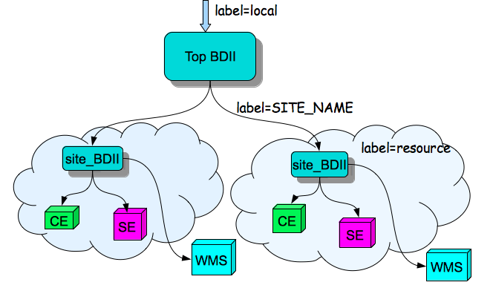
How to query Information system
# ldapsearch -x -H ldap://<hostname>:2170 -b mds-vo-name=<label>,o=grid

Slide 14
How to query Information system
Query resource (CE or SE or ...)
# ldapsearch -x -H ldap://<resource_host>:2170 \
-b mds-vo-name=resource,o=grid
Query site-level BDII
# ldapsearch -x -H ldap://<site_bdii_host>:2170 \
-b mds-vo-name=<SITE_NAME>,o=grid
Query top-level BDII
# ldapsearch -x -H ldap://<top_bdii_host>:2170 \
-b mds-vo-name=local,o=grid

Slide 15
glue-validator
glue-validator – command to validate whether the information published by the service they are managing is compliant with Glue 1.3 and Glue 2.0
Follows – GLUE Specification v. 2.0
Usage: /usr/bin/glue-validator -t <test class> [OPTIONS]
-t --test The test class [glue1|glue2].
Server Mode: Obtains LDIF from an OpenLDAP server.
-h –host Hostname of the LDAP server
-p –port Port for the LDAP server
-b –bind The bind point for the LDAP server.
File Mode: Obtains LDIF directly from a file.
-f –file An LDIF file
Options:
-d --debug Debug level 0-3, default 0

Slide 16
Thank you
EMI is partially funded by the European Commission under Grant Agreement INFSO-RI-261611

