Slide 1
Rules of the Game
7 questions, each with 4 answers to choose from (A, B, C, D).
✔
Mark your answer on your answer sheet before the timer ends.
We will then reveal the correct answer.
✔
If you have answered correctly you may tick off the next energy level.
Let‘s see which energy level you can reach!

Slide 2
Set
Ready?
GO!

Slide 3
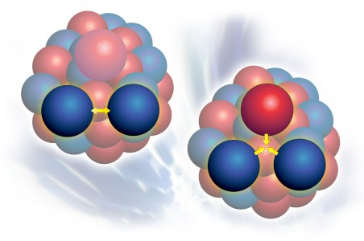

Which particle is the mediator of the strong force?
STOP
1
A. Neutralino
B. Z boson
C. Gluon
D. Quark

Slide 4
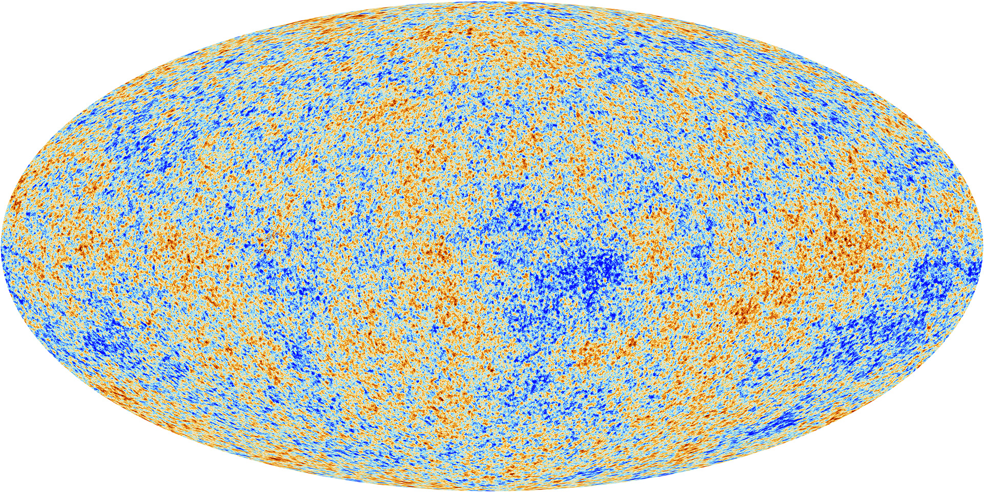
How much of our universe is matter or energy of which we know nothing about?
Planck Telescope map of the universe, ESA
STOP
2
A. 95.1 %
B. 75 %
C. 32.8 %
D. 13 %

Slide 5
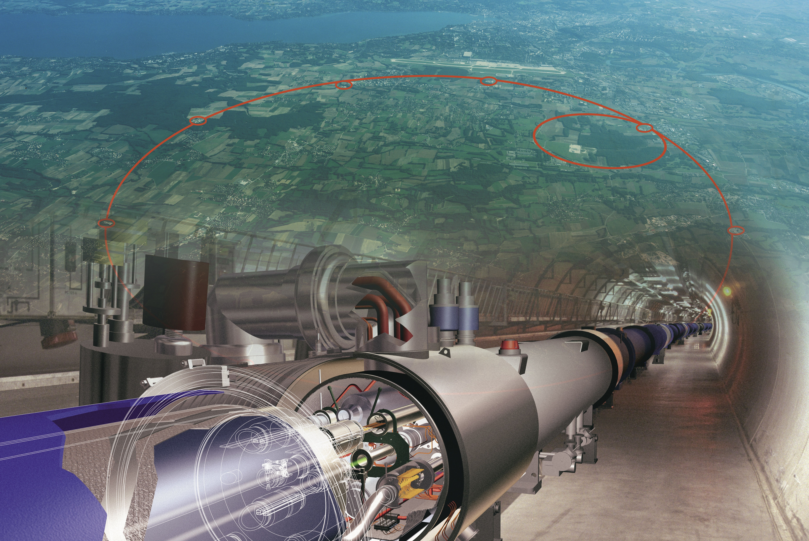
What is the power consumption of the LHC?
The same as...
STOP
3
A small village
(5000 people)
All households in Geneva canton (500,000 people)
A.
B.
Switzerland
(8M people)
France
(66M people)
C.
D.

Slide 6
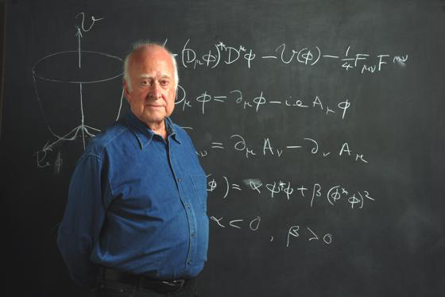
What does the Higgs field do?
STOP
4
Explain gravitational waves
Solve the origin of dark matter
A.
B.
Solve the origin of the Big Bang
Solve the origin of mass
C.
D.

Slide 7

Which of the following inventions was driven by particle physics research at CERN?
STOP
5
A. Touch screens
B. The World Wide Web
C.
D. All of the above
PET scanners

Slide 8
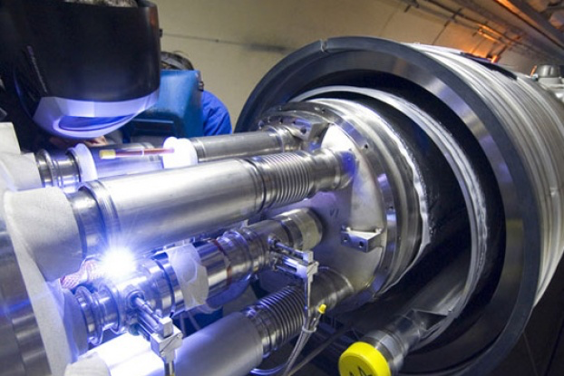
During a long run, where the proton beams might circulate for up to 10 hours, how far will these protons have travelled (assuming they have not interacted)?
STOP
6
The distance from CERN to the sun and back
The distance from CERN to Neptune and back
A.
B.
The distance from CERN to the centre of Geneva
The distance around the circumference of the Earth
C.
D.

Slide 9
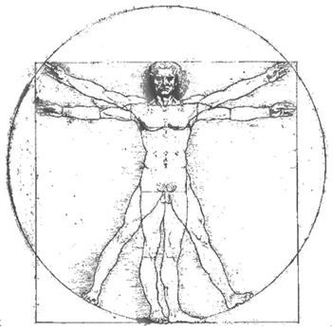
Which is the most common elementary particle in your body?
STOP
7
A. Up quark
B. Down quark
C. Electron
D. Bottom quark

Slide 10
Which energy level did you reach?

